Slide 1
Evolved ecosystems: A simulation of an emerging complex adaptive system
Presentation of Master’s thesis work by Joakim Johansson

Slide 2
Presentation outline
Introduction
Model
Results
Discussion
Conclusion

Slide 3
Introduction
Background, purpose and limitations

Slide 4
What is life?
“Life is the condition that separate living things from dead things”
Wikipedia:
Life is a characteristic distinguishing physical entities having biological processes, such as signaling and self-sustaining processes, from those that do not, either because such functions have ceased, or because they never had such functions and are classified as inanimate.
Life: The science of biology
???
“Life is the condition that separate living things from dead things”

Slide 5
Artificial life
A categorization
Wet alife
Software-based
Hard alife
Soft alife
Biochemical-based
Synthetic biology
Hardware-based
Robots
Computer-simulated life

Slide 6
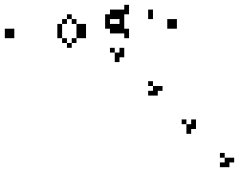
https://commons.wikimedia.org/wiki/File:Gospers_glider_gun.gif
https://en.wikipedia.org/wiki/File:Polyworld.gif
https://commons.wikimedia.org/wiki/File:Avida_2.6_screenshot.png
Conway's Game of Life - 1970
Polyworld – 1990
Avida – 1993

Slide 7
This project will be on the level of basic research in principles of the following:
Background
Open-ended evolution
Ecosystems evolution
Niche construction
Ecosystems engineering

Slide 8
Model

Slide 9
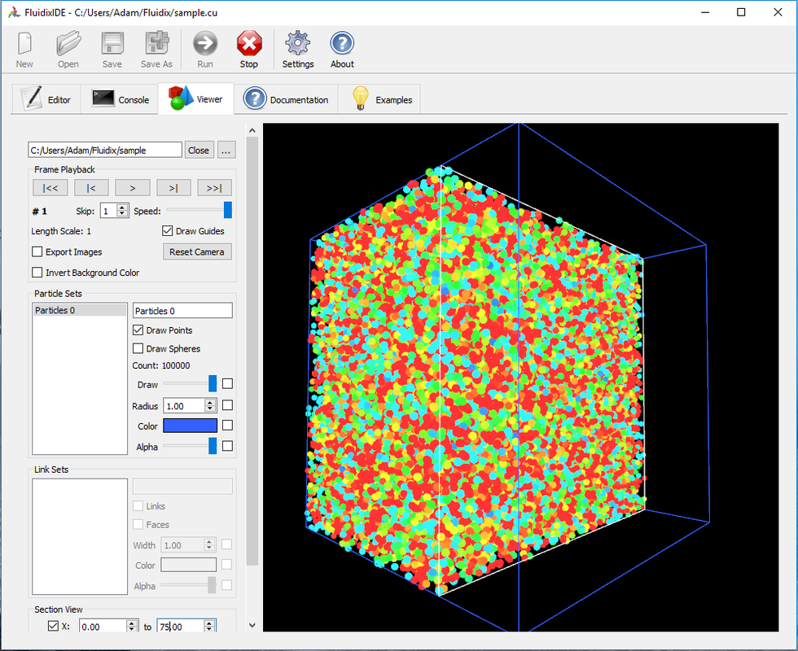
Fluidix library
CUDA-based particle simulation
Used for controlling local particle interactions
http://www.fluidix.ca/

Slide 10
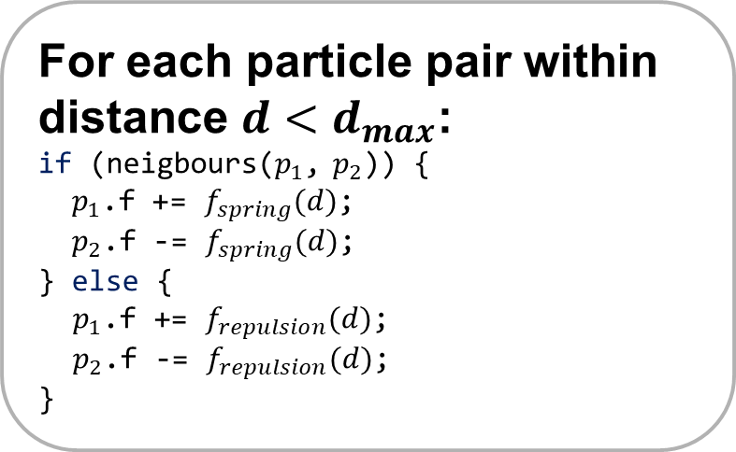
For each particle:
//integrate:
p.v += p.f * dt;
p.r += p.v * dt;
p.f = 0;
p.v *= 0.97f; //friction
Particle based simulation physics
Particle p
Position r
Velocity v
Force f
...
Physics calculation
For each particle pair within distance $d<d_{max}$:
if (neigbours($p_{1}$, $p_{2}$)) {
$p_{1}$.f += $f_{spring}(d)$;
$p_{2}$.f -= $f_{spring}(d)$;
} else {
$p_{1}$.f += $f_{repulsion}(d)$;
$p_{2}$.f -= $f_{repulsion}(d)$;
}

Slide 11
Particle types
Cell
Pellet
Building blocks of organisms
Buffer
Energy
Dead cells
Checks for visible sky for photosynthesis
Keeps # of particles constant

Slide 12
Cell types
Photo
Digest
Sting
Vascular
Create energy from light
Consume dead cells
Steal energy from foreign cells
Transport energy within organism
Fat
Store energy
Sense
Sensor input to nervous system
Egg
Store energy and form new organism at threshold

Slide 13
CPPN-neat encoding
Artificial genome
Compositional Pattern Producing Networks
Stanley (2007)
Neuroevolution of Augmenting Topologies
Stanley (2002)

Slide 14
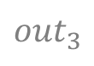
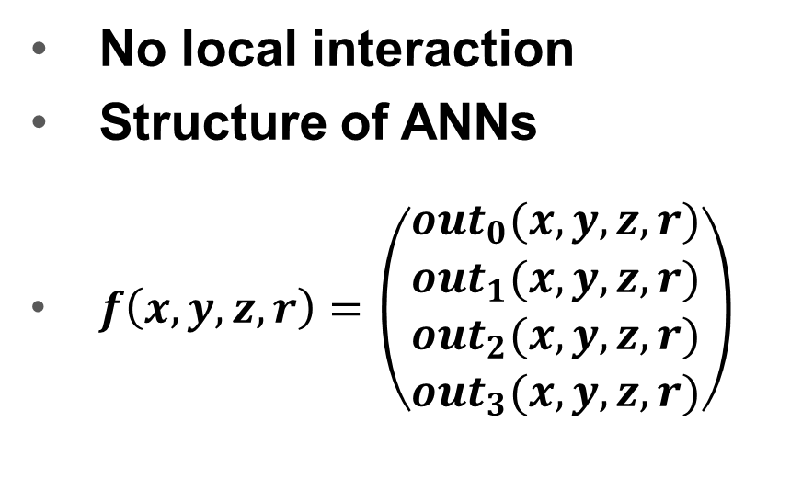

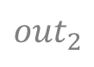
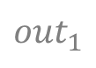
Input
x
y
z
r
CPPN
Compositional Pattern Producing Networks
No local interaction
Structure of ANNs
$f\left(x,y,z,r\right)=\left(\begin{matrix}{out}_{0}(x,y,z,r) \\ {out}_{1}(x,y,z,r) \\ \begin{aligned}{out}_{2}(x,y,z,r) \\ {out}_{3}(x,y,z,r)\end{aligned}\end{matrix}\right)$
Output
$${out}_{0}$$
$${out}_{1}$$
$${out}_{2}$$
$${out}_{3}$$

Slide 16
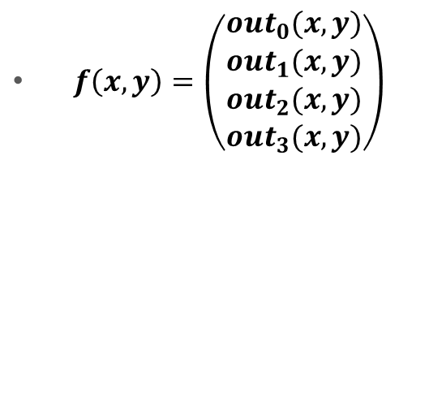
CPPN
-2
-2
Encoding patterns - Example
 | -2 | -1 | 0 | 1 | 2
-2
-1
0
1
2
-1
 | -2 | -1 | 0 | 1 | 2
-2
-1
0
1
2
-1
-1
-1
$f\left(x,y\right)=\left(\begin{matrix}{out}_{0}(x,y) \\ {out}_{1}(x,y) \\ \begin{aligned}{out}_{2}(x,y) \\ {out}_{3}(x,y)\end{aligned}\end{matrix}\right)$
0
0
-1
0
0
-1
0
1
-1

Slide 17
CPPN
-2
-1
Encoding patterns - Example
 | -2 | -1 | 0 | 1 | 2
-2
-1
0
1
2
-1
 | -2 | -1 | 0 | 1 | 2
-2
-1
0
1
2
-1
-1
-1
$f\left(x,y\right)=\left(\begin{matrix}{out}_{0}(x,y) \\ {out}_{1}(x,y) \\ \begin{aligned}{out}_{2}(x,y) \\ {out}_{3}(x,y)\end{aligned}\end{matrix}\right)$
0
0
-1
0
0
-1
0
1
-1

Slide 18
CPPN
-2
0
Encoding patterns - Example
 | -2 | -1 | 0 | 1 | 2
-2
-1
0
1
2
0
 | -2 | -1 | 0 | 1 | 2
-2
-1
0
1
2
-1
0
0
$f\left(x,y\right)=\left(\begin{matrix}{out}_{0}(x,y) \\ {out}_{1}(x,y) \\ \begin{aligned}{out}_{2}(x,y) \\ {out}_{3}(x,y)\end{aligned}\end{matrix}\right)$
1
1
-1
1
1
0
1
0
0

Slide 19
CPPN
x
y
Encoding patterns - Example
 | -2 | -1 | 0 | 1 | 2
-2
-1
0
1
2
$f\left(x,y\right)=\left(\begin{matrix}{out}_{0}(x,y) \\ {out}_{1}(x,y) \\ \begin{aligned}{out}_{2}(x,y) \\ {out}_{3}(x,y)\end{aligned}\end{matrix}\right)$

Slide 20
Neuroevolution of Augmenting Topologies
Mutation toolbox:
Mutate connection weights
Add connection
Add node
# of inputs = 2
# of outputs = 3
Example: Start with fully connected network

Slide 21
What is an organism?
Nervous system
List of cells
Genome
Organism
Nodes
Connections
Bounding radius
Nodes
Connections

Slide 22
Sense
1
Sense
2
Bias
Nervous system
Another network for each organism
Same structure as CPPN
Input from sensor cells and a bias node
Output to movement force vector
f.x
f.y
f.z

Slide 23
Results

Slide 24
